Slide 1
Moral limits to the markets

Slide 2
Labor standards: issues that direcly affect workers, including occupational health and safety, child labour, minimum wages, …
Ex: Labor Side Agreement under NAFTA- to improve the enforcement of such laws
Pro:
Labor unions : for solidarity and concern that poor labor standards create more competition and unemployment in developed countries
Consumers
NGOs-”corporate responsibility”

Slide 4
Economists’ skepticism
Attempt to enforce minimum labor standards may be a form of disguised protectionism
“The demand for linkage between trading rights and observance of standards with respect to the environment and labour would seem to arise form protectionist motives” (Srinivasan, Yale University)
“The real danger of using trade sanctions as instrument for promoting basic rights is that the trade-standards linkage could become highjacked by protectionist interets attempting to preserve activities rendered uncompetitive by cheaper imports” (The World Bank)
“ The professed concern about workers welfare is motivated by selfish interest…to put as many obstacles as possible in the way of anyone attempting to catch up and compete with the West” (Prime Minister of Malasya, Mahathir bin Mohammed)

Slide 5
Economists’ skepticism
Several US trade laws give the President the power to withhold trade privileges from countries that do not give their workers basic rights, including the right to organize.
Problems:
Denying preferences across all industries is not adequate.
Countries should be free to choose their own policies.
They may produce unemployment (ex: Indonesia-minimum wage doubled in real terms but unemployment increased 10%).

Slide 6
Environment: the role of multilateral enforcement
Multilateral Environment agreements (around 200)- ex: Convention on international trade in endangered species; Montreal Protocol on Substances that Deplete the Ozone Layer (which has eliminated the use of chlorofluorocarbonet, CGCs);Kyoto Protocol (for global warming)
WTO does not deal directly with environemnt

Slide 7
Environment issues on GATT and WTO
Article XX- allows countries to adopt their own laws in relation to environmental issues, provided that laws are applied uniformly to domestic and foreign producers so that the laws do not discriminate against imports.

Slide 8
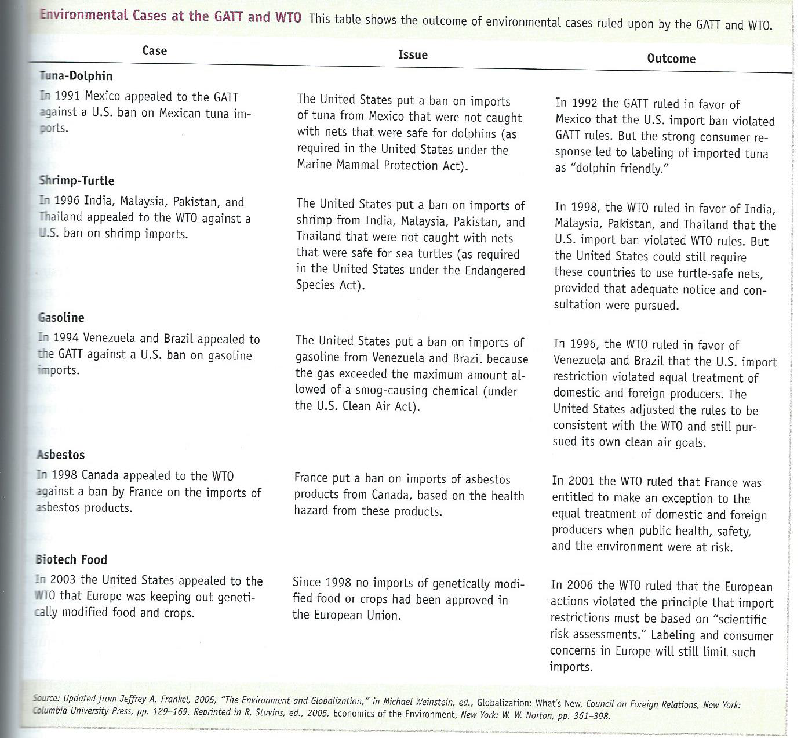

Slide 9
Does trade help or harm the environment?
It may help
US sugar quota: prevents ethanol production based on sugar-leads firms to using instead corn, less energy efficient and which depletes the soil.
Automobile VER: Japan exported larger and /or more luxurious models, less fuel-efficient cars (producing greater carbon dioxide emissions)

Slide 10
Does trade help or harm the environment?
Or harm
The tragedy of the commons: a resource is treated as common property that anyone can harvest (ex: overfishing atlantic cod, tuna in Mediterranean, sturgeon in European and Asian waters-29% of fish and seafood species have coplased)
Alternative: system of rules that assign property rights to the resource and limits the harvest+international agreement

Slide 11
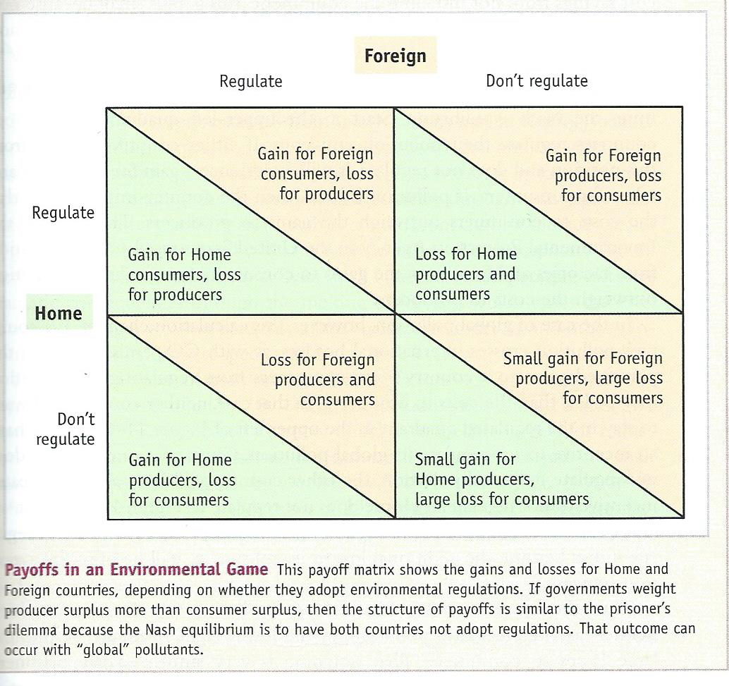

Slide 12
The moral limits of markets (Michael Sandel
https://www.youtube.com/watch?v=UbBv2ZGC2VI

